Slide 1
Introduction to React JS
With ES6

Slide 2
Agenda
React Router
Forms
Introduction to Flux
React-Redux
Unit testing
Debugging
Webpack Adds On and Release Builds
Quiz

Slide 3

Overview
By the end of Day 02 you should be able to
Set up a project with React Router
Build Forms
Understand the basics of Flux and Redux
Unit test your application
Debug your application
Get your application prod ready

Slide 4
Agenda
React Router
Forms
Introduction to Flux
React-Redux
Unit testing
Debugging
Webpack Adds On and Release Builds
Quiz

Slide 5

React Router
For each link a new url is updated for bookmarking.
Each url should represent a state
Content for route 1
Partial HTML files
Content for route 3
Content for route 2
link1
link2
JSON Data
link3
Images

Slide 6
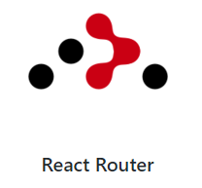
React Router
React Router – popular React solution
UI is in-sync with the URL
Components get unmounted and mounted automatically when URL changes
URLs can be manipulated manually or programmatically

Slide 7

React Router
React Router
Router
Route
Link
Notes:
React Router provides three components to get started:
Router and Route: Used to declaratively map routes to your application's screen hierarchy.
Link: Used to create a fully accessible anchor tag with the proper href.

Slide 8
React Router
Index Route
Pass props
Pass parameter
Clone and inject props

Slide 9
React Router
Change the routes dynamically
React Router automatically injects its history object into all components that it mounts.
The history object is responsible for managing the browser's history stack, and provides the methods
Method | Description
pushState | The basic history navigation method transitions to a new URL. You can optionally pass a parameters object.
replaceState | Has the same syntax as pushState, but it replaces the current URL with a new one
goBack | Go back one entry in the navigation history.
goForward | Go forward one entry in the navigation history.
createHref | Go forward one entry in the navigation history.

Slide 10
Agenda
React Router
Forms
Introduction to Flux
React-Redux
Unit testing
Debugging
Webpack Adds On and Release Builds
Quiz

Slide 11
Forms
Forms are critical and crucial.
Form components such as <input>, <textarea>, and <option> differ from their HTML counterparts because they can be mutated via user interactions
Forms
Uncontrolled Components
Controlled Components

Slide 12
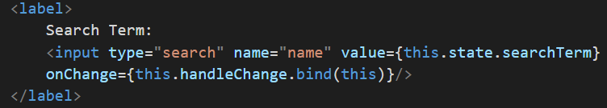
Forms
Controlled Components
A form component with a value or checked prop is called a controlled component.
In a controlled component, the value rendered inside the element will always reflect the value of the prop.
By default the user won't be able to change it.
The only way to change is to change the component’s state.
Change the state via events

Slide 13
Forms
Controlled Components Advantages
It stays true to the React way of handling components. The state is kept out of the interface, and is entirely managed in your JavaScript code.
This pattern makes it easy to implement interfaces that respond to or validate user interactions. For example, you could very easily limit the user input to 50 characters:

Slide 14
Forms
Uncontrolled Components
Anti-pattern for how most other components are constructed in React
Sometimes you don't need to oversee the user input field by field.
When there is a large form, we need only the final value and in that case uncontrolled components are used

Slide 15
Agenda
React Router
Forms
Introduction to Flux
React-Redux
Unit testing
Debugging
Webpack Adds On and Release Builds
Quiz

Slide 16

Introduction to Flux
Flux is the application architecture that Facebook uses for building client-side web applications.
It complements React's composable view components by utilizing a unidirectional data flow.
It's more of a pattern rather than a formal framework, and you can start using Flux immediately without a lot of new code.
Centralized Dispatcher
A Pattern
Unidirectional Data Flows
https://facebook.github.io/flux

Slide 17
Introduction to Flux
Delorean
Facebook’s Flux
NuclearJS
Alt
Fluxible
Reflux
Flummox
Marty
Redux

Slide 18
Introduction to Flux
Two Way Databinding
Unidirectional
Action
View Model
Any Action eg: Deposit Money, Withdraw Money
Dispatcher
View
Notify everyone who cares
Store
Hold App State and logic
View

Slide 19
Introduction to Flux
action
Encapsulate Events
dispatcher
Central Hub –There’s only one
store
Holds app state, logic, data retrieval
Views
Triggered by user interactions and server
Passed to dispatcher
Action has a Type and a data
Holds list of callbacks
Broadcasts payload to registered callbacks
Sends actions to stores
Not a model –Contains models.
One, or many registers callbacks with dispatcher
Uses Node’s EventEmitter
Top level component
Interacts with Stores
Holds data in state
Sends data to children as props

Slide 20
Introduction to Flux
Flux Utils
provides basic utility classes to start with Flux.
Might not handle all the complex scenarios
Go for other frameworks to fullfil all your needs like redux
Stores
Provides three stores Store, ReduceStore and MapStore
ReduceStore is a very special kind of store. Its name comes from the fact that it uses reducing functions to modify its internal state.

Slide 21
Introduction to Flux
Reducer is a function that calculates a new state given the previous state and an action. The state in a ReduceStore must necessarily be treated as immutable
Single primitive values (a string, Boolean value, or a number)
An array or primitive values, as in [1, 2, 3, 4]
An object of primitive values, as in {name:'cassio', age:35}
An object with nested objects that will be manipulated using React immutable helpers
Actions
Actions are static methods that dispatches the payload – (constants+data)

Slide 22
Introduction to Flux
Views
Contains the render method, along with static method getStores, calculateState – needed for creating a FluxContainer
Dispatcher
Class that extends the Dispatcher that dispatches the payload(actions)
Notes:
Create a simple Bank application to understand

Slide 23
Agenda
React Router
Forms
Introduction to Flux
React-Redux
Unit testing
Debugging
Webpack Adds On and Release Builds
Quiz

Slide 24

Redux
Simple Application – Plain Javascript or jQuery is enough
Redux is needed for a complex dataflows.. Redux is complex to code and initial setup is tedious. But once set the application is simple to maintain and test.
Need for Redux
Complex data flows
Inter-component communication (that don’t have a parent-child relationship )
Non-hierarchical data
Many actions
Same data used in multiple places
Redux is a predictable state container for JavaScript apps.

Slide 25
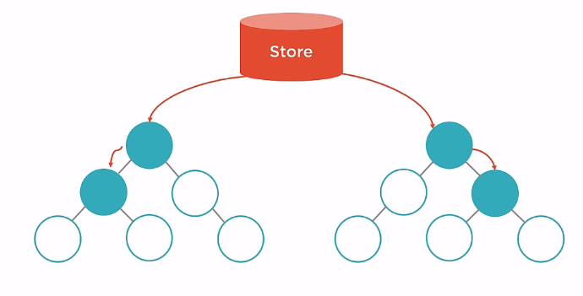
Redux

Slide 26



Redux
Actions Trigger Changes
Reducers Update State
One immutable Store

Slide 27
Redux
Flux
Redux
Action
Action
Dispatcher
Store
Reducers
Store
View
View

Slide 28
Redux
Flux and Redux are two different ways that can handle state and data flows in an React application.
Similarities – Both follow One way Data Flow,have Actions and Stores
Flux | Redux
Stores contain state and change logic | Store and change logic are separate
Multiple stores | One store
Flat and disconnected stores | Single store with hierarchical reducers
Singleton dispatcher | No dispatcher
React components subscribe to stores | Container components utilize connect
State is mutated | State is immutable

Slide 29
Redux
Immutability → To change a state return a new state
What is immutable in JS
Number
String
Boolean
Undefined
Null
What is mutable in JS
Objects
Arrays
Functions
ES6 | ES5 | Libraries
Object.assign | Lodash Merge | React-addson-update
Spread Operator | Lodash Extend | Immutable.js
 | Object-assign

Slide 30
Redux- Store
In Redux, the store is what holds the application’s state data and handles all state updates.
While the Flux design pattern allows for many stores that each focus on a specific set of data, Redux only has one store.
The store handles state updates by passing the current state and action through a single reducer.
We will create this single reducer by combining and composing all of our reducers.
Stores allow you to subscribe handler functions that are invoked every time the store completes dispatching an action

Slide 31
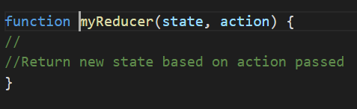
Redux-reducers
Our entire state tree is stored in a single object.
Functions are used to update parts of state tree – These functions are reducers
Reducers are functions that take the current state along with an action as arguments and use them to create and return a new state.
Reducers are designed to update specific parts of the state tree, either leaves or branches.
Reducers are pure functions.
Produce the same result for the same input all the time
Should not mutate arguments
Should not perform side effects
Should not call non-pure functions

Slide 32
react-redux
react-redux, but it reduces the boilerplate code
This library is also brought to you by Dan Abramov, the creator of Redux.
npm install react-redux --save
react-redux supplies us with a component that we can use to set up our store in context, the Provider.

Slide 33
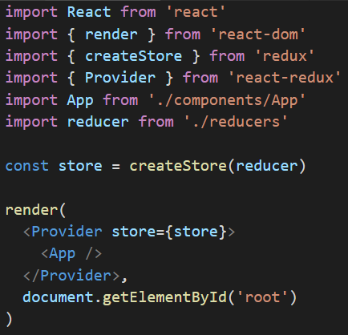
react-redux
Wrap any React element with the provider and that element’s children will have access to the store via context.
The Provider adds the store to context and updates the App when actions have been dispatched.
The provider expects a single child component and expects to add a store as a property

Slide 34
react-redux
Connect is a higher order function that returns a function that returns a component.
Connect expects two arguments: mapStateToProps, and mapDispatchToProps, both are functions. It returns a function that expects a presentational component and wraps it with a container that sends it data via props.
mapStateToProps
injects state as an argument and returns an object that will be mapped to props
mapDispatchToProps
injects the stores dispatch function as an argument
Connect works in conjunction with the Provider. The Provider adds the store to context and connect creates components that retrieve the store.
Notes:
React Redux helps us create container components through mapping the current state of the Redux store to the properties of a presentational component.
It also maps the store’s dispatch function to callback properties.
This is all accomplished through using a higher order function called connect.

Slide 35
Agenda
React Router
Forms
Introduction to Flux
React-Redux
Unit testing
Debugging
Webpack Adds On and Release Builds
Quiz

Slide 36
Course wrap up
Next steps suggestions
End

